Slide 1




Lens Calibration
Summarized Lens Calibration process
Print a pattern and attach it to a planar surface.
Take several images with different locations and orientations by moving either the plane or camera.
Detect the corners of the chessboard.
Estimate intrinsic and extrinsic parameters.
Refine the found parameters.
Obtain the distortion parameters and undistort the image.
Repeat 4~6 until all the parameters converge.
Harry’s operator
Forstner’s algorithm
Suzuki’s algorithm
Alexander’s algorithm
etc.
$←$ Corner detector algorithm.
$←$ Zhang’s technique.
$←$ The Levenberg-Marquardt algorithm.
$←$ The Brown-Conrady model.

Slide 2
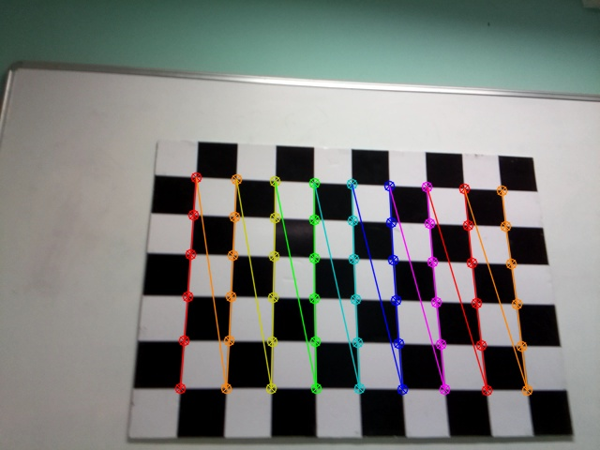









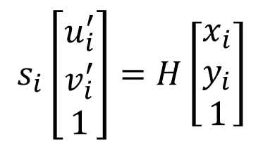


Homography matrix
Sensor coordinate
World coordinate
53rd : $\left(5,8\right)$
640 pixels
$$x$$
$6×9$ corners
53rd : $\left(x_{53}^{′},y_{53}^{′}\right)$
5th : $\left(5,0\right)$
480 pixels
$$y$$
2nd
1st : $\left(1,0\right)$
1st
0th : $\left(0,0\right)$
6th
6th
0th : $\left(u_{0}^{′},v_{0}^{′}\right)$
$$s_{i}\left[\begin{matrix}u_{i}^{′} \\ v_{i}^{′} \\ 1\end{matrix}\right]=H\left[\begin{matrix}x_{i} \\ y_{i} \\ 1\end{matrix}\right]$$
$\left(x_{i}, y_{i}\right)$: a world coordinate of a corner.
$\left(u_{i}, v_{i}\right)$: a sensor coordinate of a corner (undistorted).
$\left(u_{i}^{′}, v_{i}^{′}\right)$: a sensor coordinate of a corner (distorted).
※ We assume $z=0$ for all corners in the world coordinates.

Slide 3
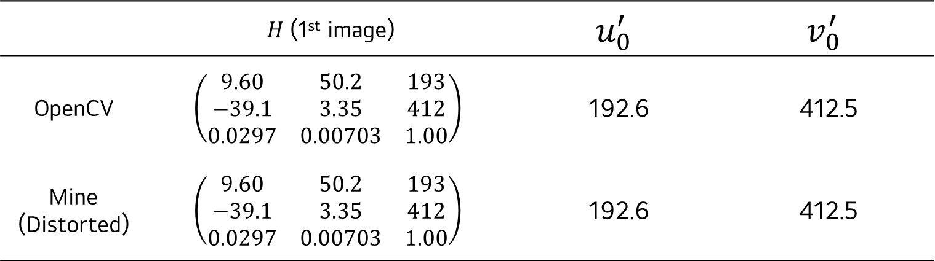
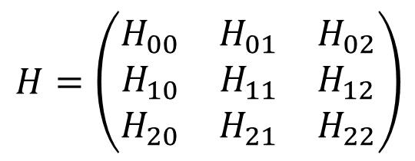
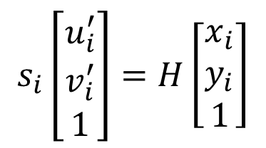
Homography matrix
Obtaining the Homogeneous matrix by using SVD.
$$s_{i}\left[\begin{matrix}u_{i}^{′} \\ v_{i}^{′} \\ 1\end{matrix}\right]=H\left[\begin{matrix}x_{i} \\ y_{i} \\ 1\end{matrix}\right]$$
$H=$ $\left(\begin{matrix}H_{00} & H_{01} & H_{02} \\ H_{10} & H_{11} & H_{12} \\ H_{20} & H_{21} & H_{22}\end{matrix}\right)$
The location of the 0th corner in the distorted image
 | $H$ (1st image) | $$u_{0}^{′}$$ | $$v_{0}^{′}$$
OpenCV | $$\left(\begin{matrix}9.60 & 50.2 & 193 \\ −39.1 & 3.35 & 412 \\ 0.0297 & 0.00703 & 1.00\end{matrix}\right)$$ | 192.6 | 412.5
Mine (Distorted) | $$\left(\begin{matrix}9.60 & 50.2 & 193 \\ −39.1 & 3.35 & 412 \\ 0.0297 & 0.00703 & 1.00\end{matrix}\right)$$ | 192.6 | 412.5

Slide 4
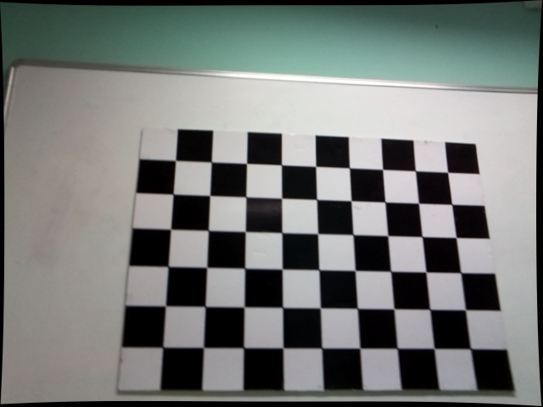

Homography matrix
Distorted image
A corner in the distorted image
A corner in the undistorted image found by suing OpenCV
Undistorted image (OpenCV)
$$e=\left(u_{0}−u_{0}^{′}, v_{0}−v_{0}^{′}\right)$$

Slide 5
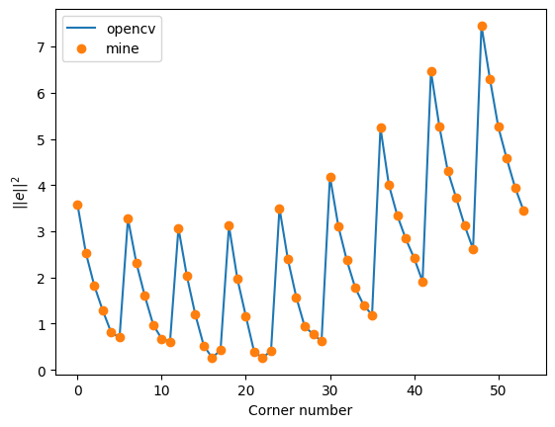
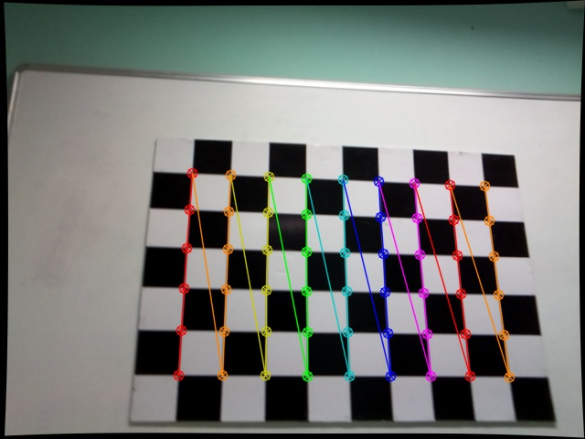
Homography matrix
Distorted image
48
5
54
4
3
2
1
0
6
12
48
0
6
12
Undistorted image (OpenCV)
1
54
2

Slide 6
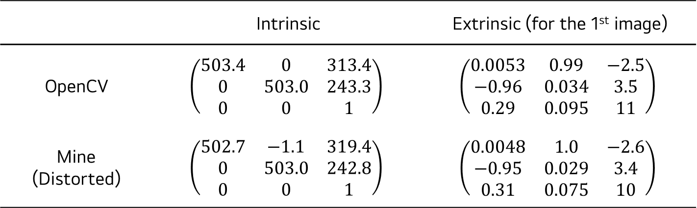
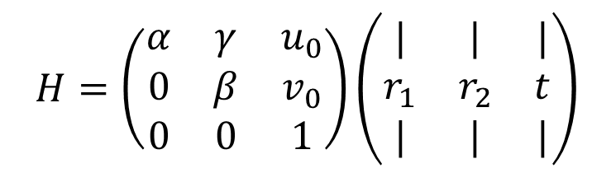
Homography matrix
Obtaining the intrinsic and extrinsic parameters by using Zhang’s technique.
$H=$ $\left(\begin{matrix}α & γ & u_{0} \\ 0 & β & v_{0} \\ 0 & 0 & 1\end{matrix}\right)\left(\begin{matrix}| & | & | \\ r_{1} & r_{2} & t \\ | & | & |\end{matrix}\right)$
intrinsic parameters
extrinsic parameters
 | Intrinsic | Extrinsic (for the 1st image)
OpenCV | $$\left(\begin{matrix}503.4 & 0 & 313.4 \\ 0 & 503.0 & 243.3 \\ 0 & 0 & 1\end{matrix}\right)$$ | $$\left(\begin{matrix}0.0053 & 0.99 & −2.5 \\ −0.96 & 0.034 & 3.5 \\ 0.29 & 0.095 & 11\end{matrix}\right)$$
Mine (Distorted) | $$\left(\begin{matrix}502.7 & −1.1 & 319.4 \\ 0 & 503.0 & 242.8 \\ 0 & 0 & 1\end{matrix}\right)$$ | $$\left(\begin{matrix}0.0048 & 1.0 & −2.6 \\ −0.95 & 0.029 & 3.4 \\ 0.31 & 0.075 & 10\end{matrix}\right)$$

Slide 7
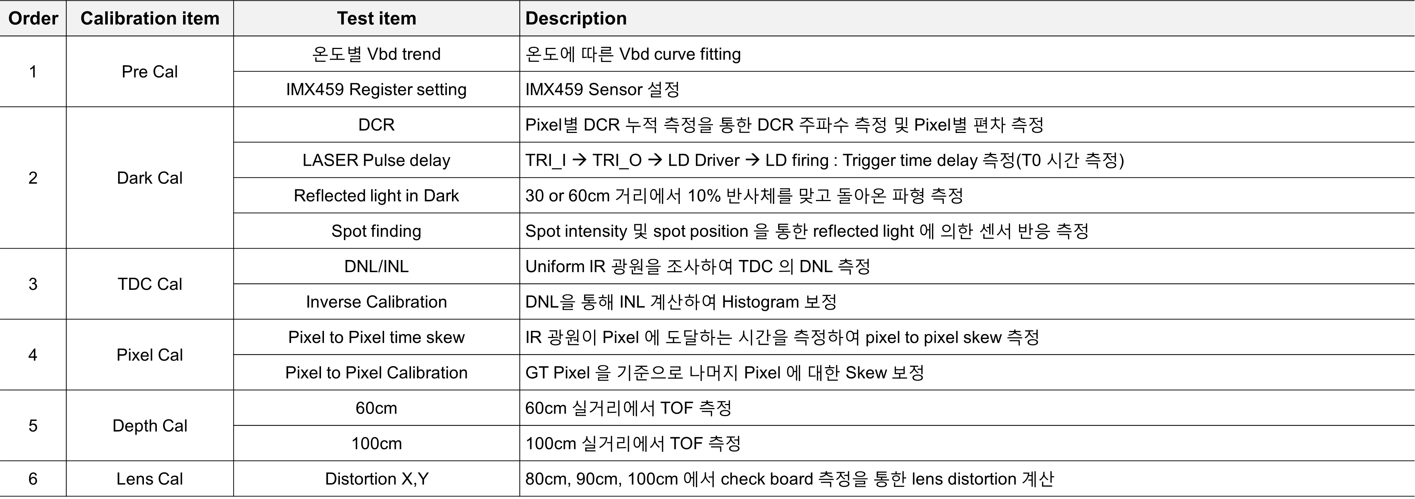
S-LiDAR Cal. (Dark, TDC, P2P)
Item | 인원 | 6월2주 | 6월3주 | 6월4주 | 7월1주 | 7월2주 | 7월3주 | 7월4주 | 8월1주 | 8월2주 | 8월3주 | 8월4주 | 11월
Dark, TDC, P2P Cal. 장비 | 성동현 이동건 이석민
DNL용
IR 광원
발주
P2P
광원설계
TDC
Cal
검증
w/ IR광원
통합
Cal
장비개발
의사결정
통합
Cal
장비
설계
통합
Cal
장비
발주
EVK
입고
P2P
장비
발주
Dark
Cal
검증
실거리
TOF
Chart
측정
P2P
입고
검증
입고
ACE d-TOF Sensor Calibration 방식을 자사 S-LiDAR 에 적용
전반적이 Calibration 의 방식은 동일하지만 자사 S-LiDAR 에 적합한 장비 구성으로 Modification

Slide 8
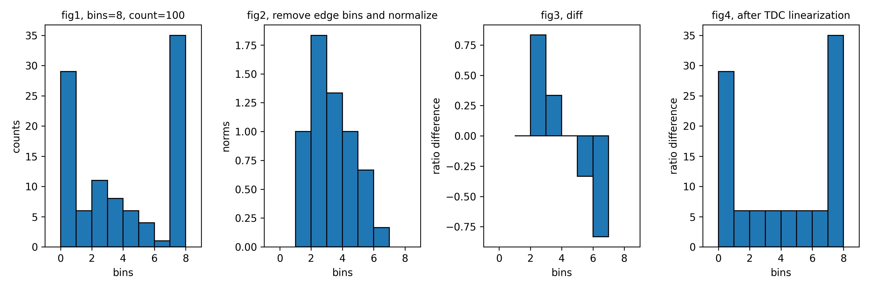
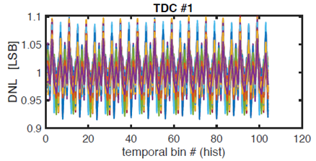

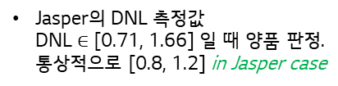
Lens Calibration
Jasper Calibration BM process
Dark Box
LPFF
Rail
P2P
$t_{0}$ measure
Spot finding
TDC Linearization.
Geo Cal.
Depth Cal.
FPN Cal.
LPFF TDC Linearization
Definition of Differential Non-Linearity
A Python test code for the TDC linearization
11
11
Ideal TDC
Real TDC
$$DNL\left(11\right)=0 LSB$$
10
10
$$DNL\left(10\right)=−0.3 LSB$$
01
01
00
V (LSB)
00
$$DNL\left(01\right)=0.5 LSB$$
V (LSB)
$$DNL\left(00\right)=−0.2 LSB$$
Jasper의 DNL 측정값 DNL $∈$ [0.71, 1.66] 일 때 양품 판정. 통상적으로 [0.8, 1.2] in Jasper case

Slide 9
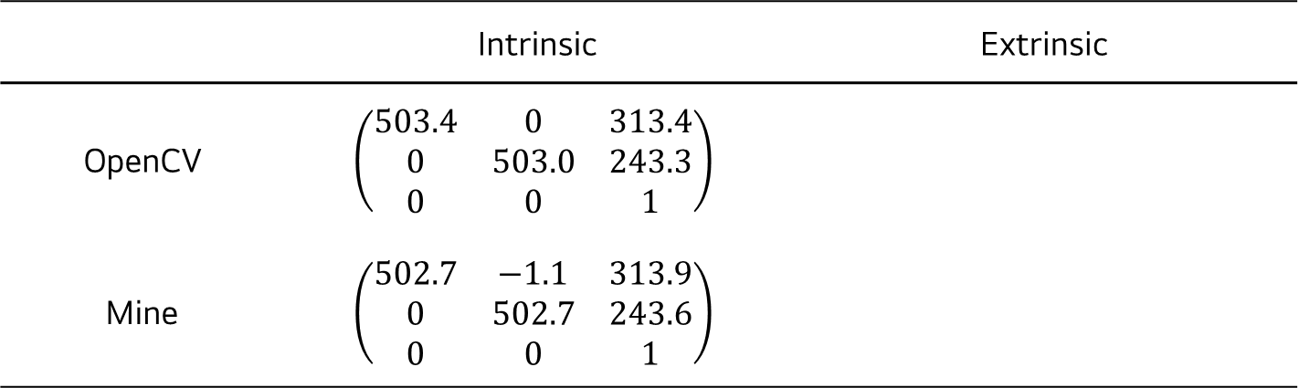
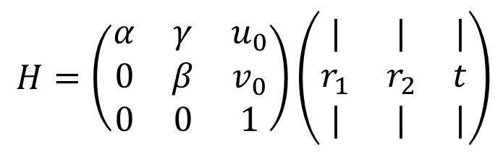
Homography matrix
Obtaining the intrinsic and extrinsic parameters by using Zhang’s technique.
$H=$ $\left(\begin{matrix}α & γ & u_{0} \\ 0 & β & v_{0} \\ 0 & 0 & 1\end{matrix}\right)\left(\begin{matrix}| & | & | \\ r_{1} & r_{2} & t \\ | & | & |\end{matrix}\right)$
intrinsic parameters
extrinsic parameters
 | Intrinsic | Extrinsic
OpenCV | $$\left(\begin{matrix}503.4 & 0 & 313.4 \\ 0 & 503.0 & 243.3 \\ 0 & 0 & 1\end{matrix}\right)$$
Mine | $$\left(\begin{matrix}502.7 & −1.1 & 313.9 \\ 0 & 502.7 & 243.6 \\ 0 & 0 & 1\end{matrix}\right)$$

Slide 10


고객가치
새로운 시도
집요한 실행
Corner detector

Slide 11
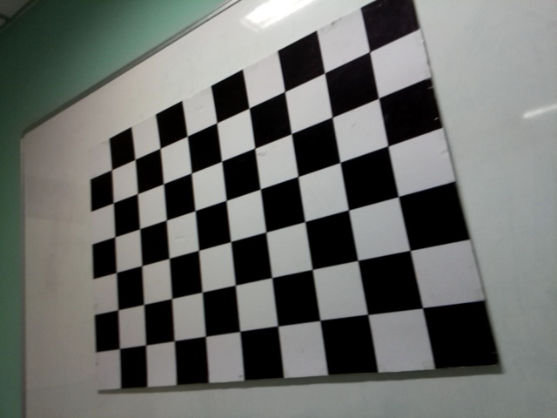
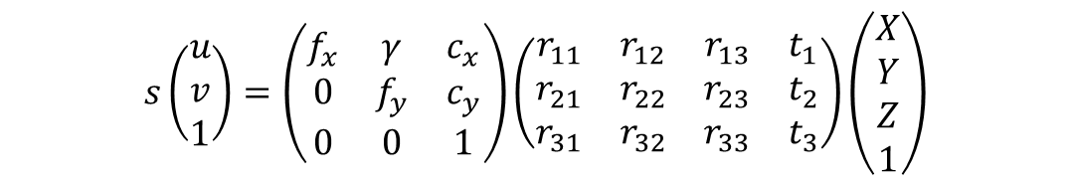
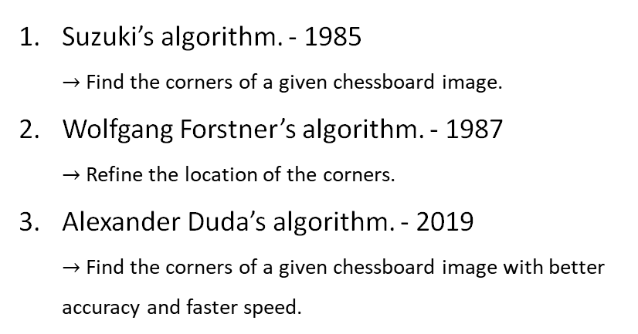

Lens Calibration
Pinhole camera equation
intrinsic
extrinsic
$$s\left(\begin{aligned}u \\ v \\ 1\end{aligned}\right)=\left(\begin{matrix}f_{x} & γ & c_{x} \\ 0 & f_{y} & c_{y} \\ 0 & 0 & 1\end{matrix}\right)\left(\begin{matrix}r_{11} & r_{12} & r_{13} & t_{1} \\ r_{21} & r_{22} & r_{23} & t_{2} \\ r_{31} & r_{32} & r_{33} & t_{3}\end{matrix}\right)\left(\begin{aligned}X \\ Y \\ Z \\ 1\end{aligned}\right)$$
$u$ and $v$ are must be well-defined to accurately calibrate the camera.
640 pixels
Suzuki’s algorithm. - 1985 $→$ Find the corners of a given chessboard image.
Wolfgang Forstner’s algorithm. - 1987 $→$ Refine the location of the corners.
Alexander Duda’s algorithm. - 2019 $→$ Find the corners of a given chessboard image with better accuracy and faster speed.
$$\left(u_{i},v_{i}\right)$$
480 pixels

Slide 12
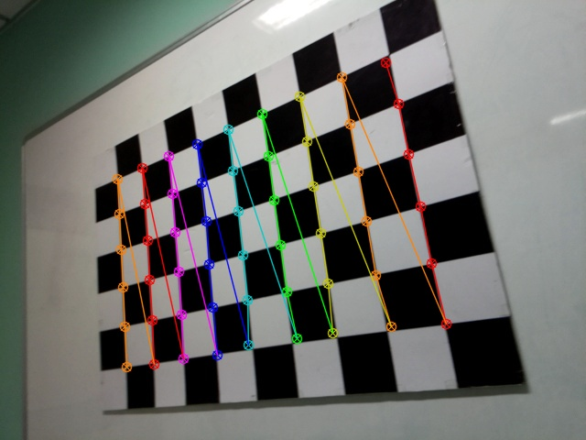

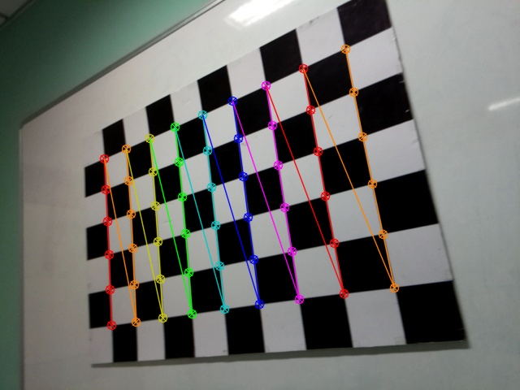

Lens Calibration
Suzuki’s algorithm
Suzuki’s + Forstner’s algorithm
Alexander Duda’s algorithm
Alexander + Forstner’s algorithm

Slide 13
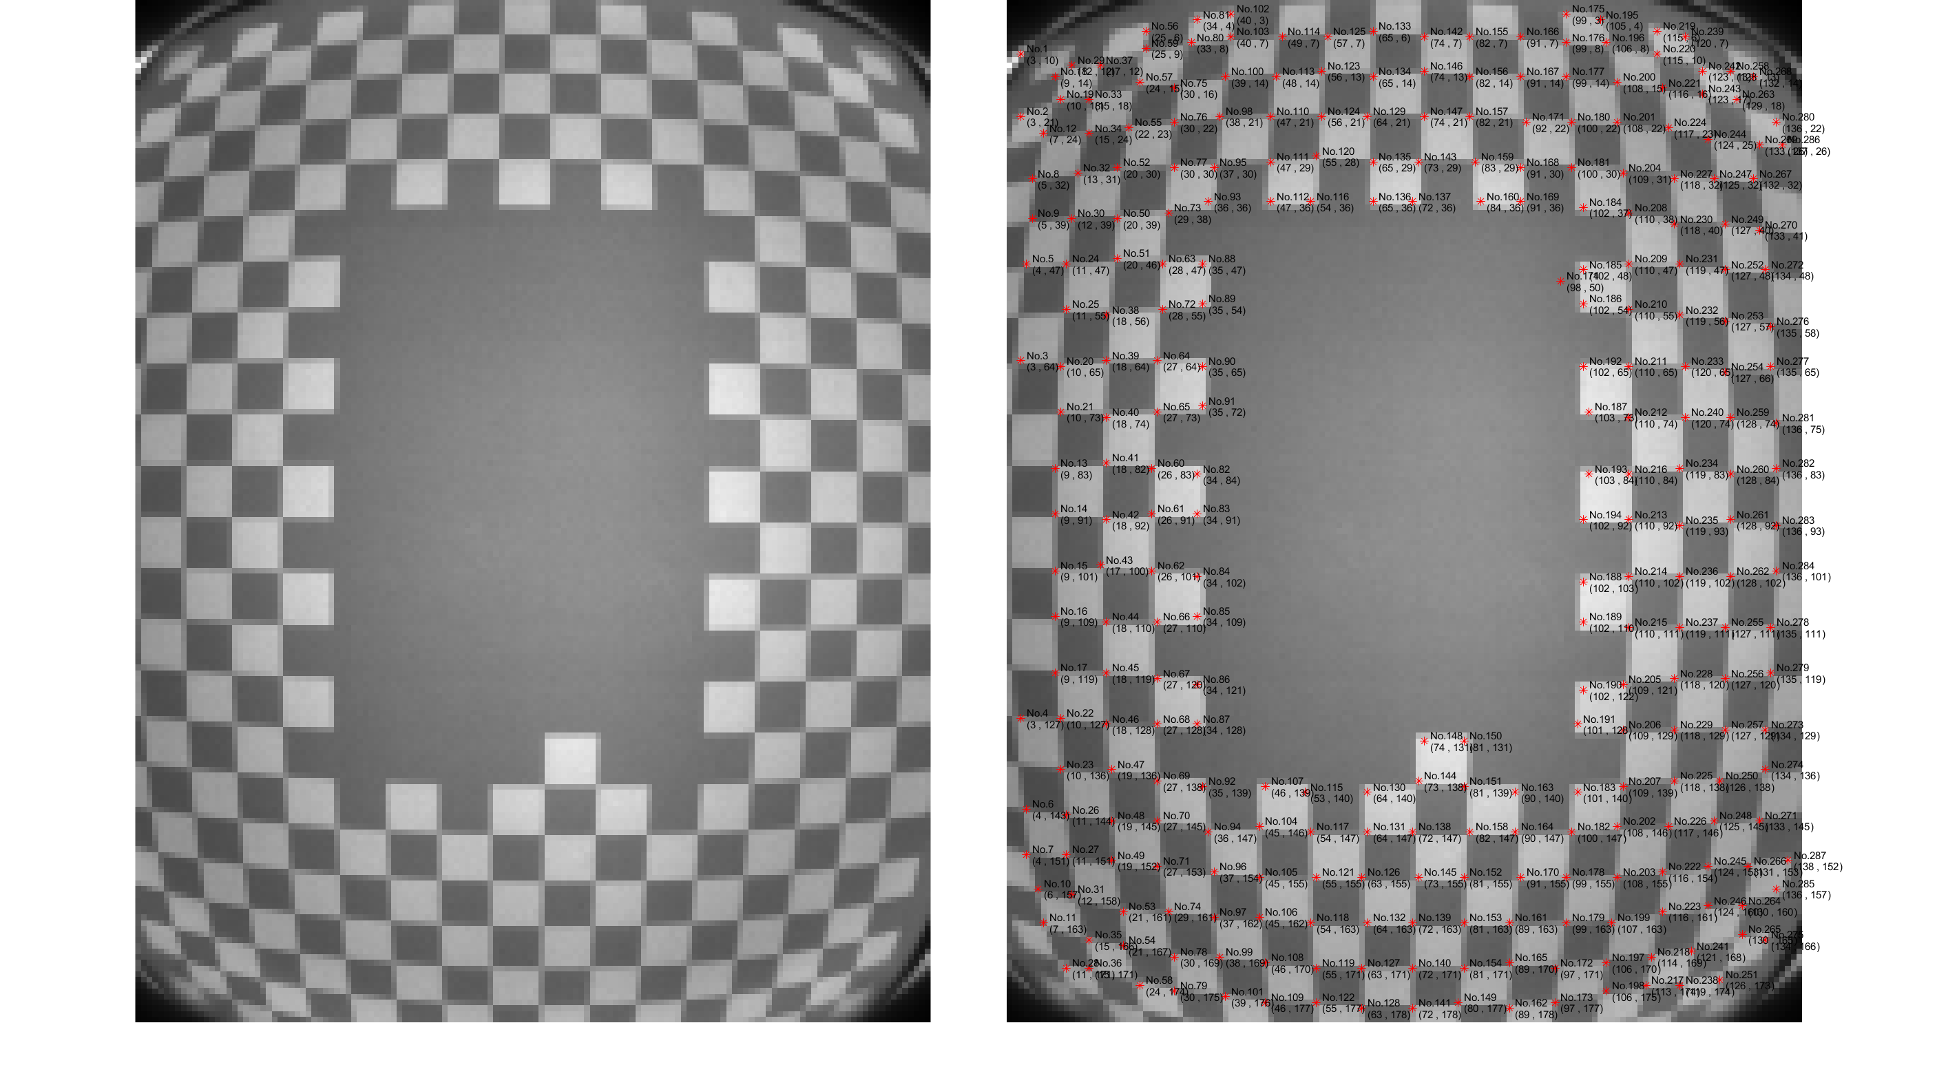

Lens Calibration
Lens Calibration in Jasper
Point localizing by hand $→$ of no uses.
100cm

Slide 14
Lens Calibration
Alexander Duda’s algorithm

Slide 15
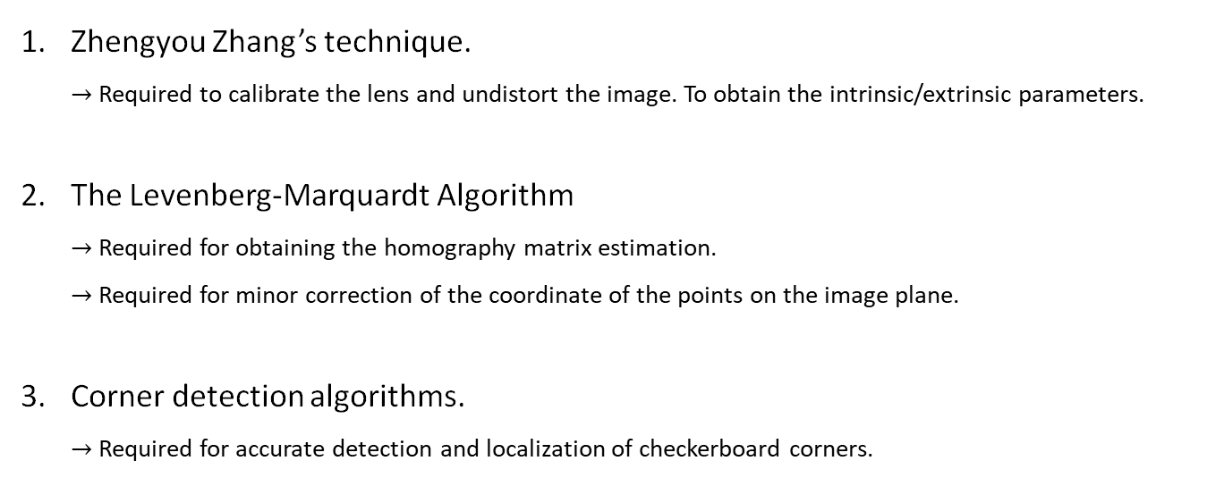
Lens Calibration
Algorithm required for Lens calibration
Zhengyou Zhang’s technique. $→$ Required to calibrate the lens and undistort the image. To obtain the intrinsic/extrinsic parameters.
The Levenberg-Marquardt Algorithm $→$ Required for obtaining the homography matrix estimation. $→$ Required for minor correction of the coordinate of the points on the image plane.
Corner detection algorithms. $→$ Required for accurate detection and localization of checkerboard corners.

Slide 16
Lens Calibration
Algorithm required for Lens calibration
Zhengyou Zhang’s technique. $→$ Required to calibrate the lens and undistort the image. To obtain the intrinsic/extrinsic parameters.
The Levenberg-Marquardt Algorithm $→$ Required for obtaining the homography matrix estimation. $→$ Required for minor correction of the coordinate of the points on the image plane.
Corner detection algorithms. $→$ Required for accurate detection and localization of checkerboard corners.

Slide 17

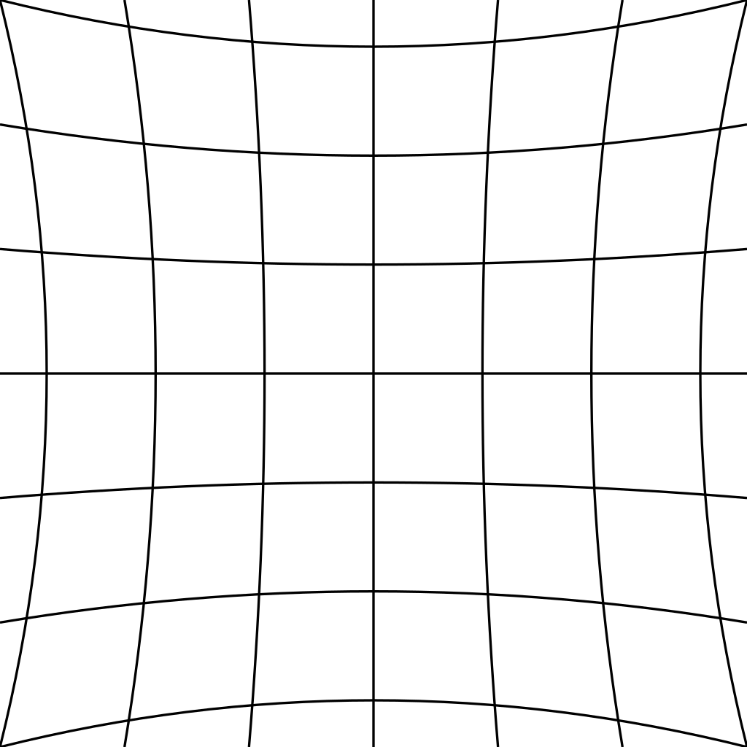
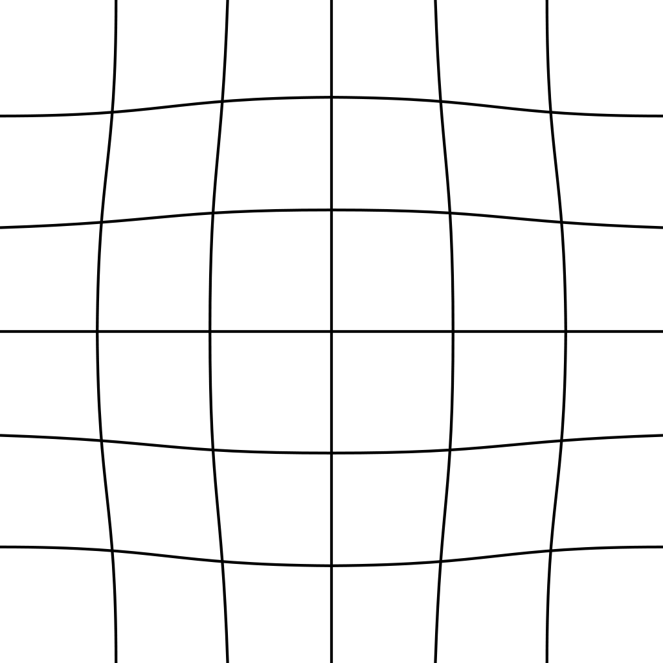
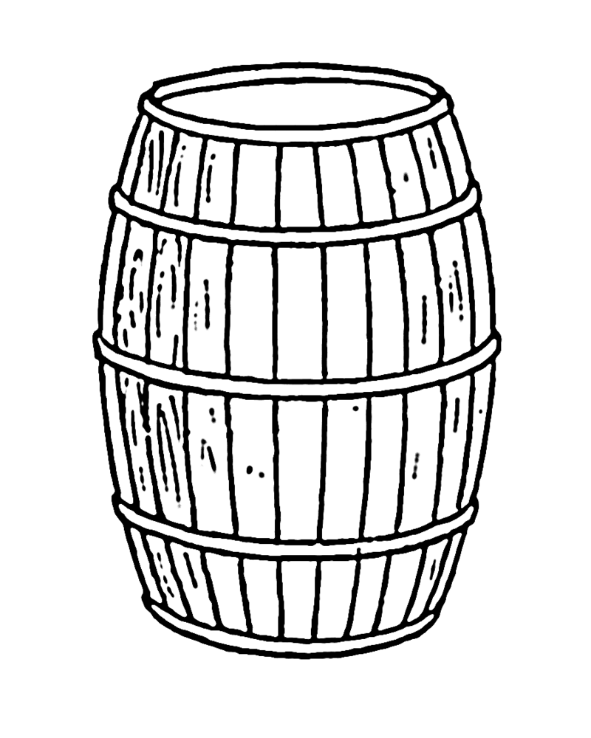


Lens Calibration: radial distortions
The three most common radial distortions
Barrel distortion
(positive radial distortion)
Pincushion distortion
(negative radial distortion)
Mustache distortion
(complex distortion)
degree 2
degree 2
degree 4

Slide 18
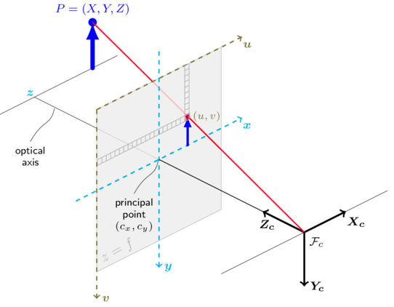
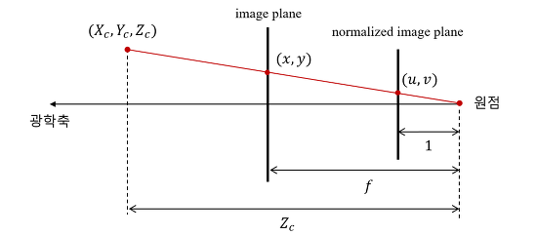
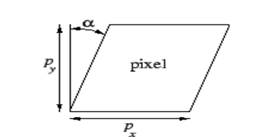
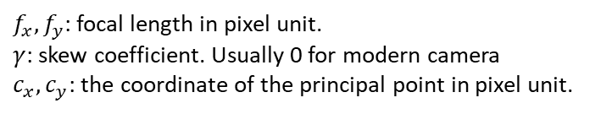
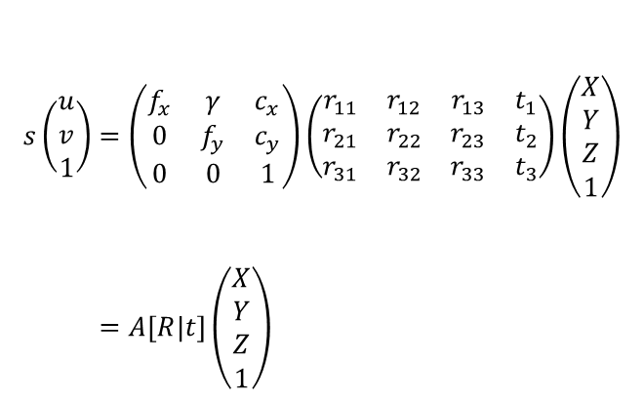


Lens Calibration: pinhole camera model
Camera matrix (Projection matrix)
$$\left(0,0,0\right)$$
optical axis
$$\left(0,0\right)$$
Image plane and
$$s\left(\begin{aligned}u \\ v \\ 1\end{aligned}\right)=\left(\begin{matrix}f_{x} & γ & c_{x} \\ 0 & f_{y} & c_{y} \\ 0 & 0 & 1\end{matrix}\right)\left(\begin{matrix}r_{11} & r_{12} & r_{13} & t_{1} \\ r_{21} & r_{22} & r_{23} & t_{2} \\ r_{31} & r_{32} & r_{33} & t_{3}\end{matrix}\right)\left(\begin{aligned}X \\ Y \\ Z \\ 1\end{aligned}\right) \\ =A\left[R|t\right]\left(\begin{aligned}X \\ Y \\ Z \\ 1\end{aligned}\right)$$
The world coordinate and the image coordinate.
$f_{x},f_{y}$: focal length in pixel unit.
$γ$: skew coefficient. Usually 0 for modern camera
$c_{x},c_{y}$: the coordinate of the principal point in pixel unit.
Skew coefficient.

Slide 19
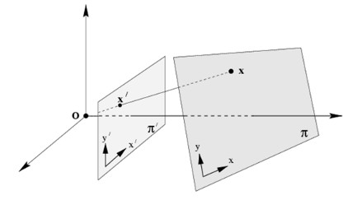
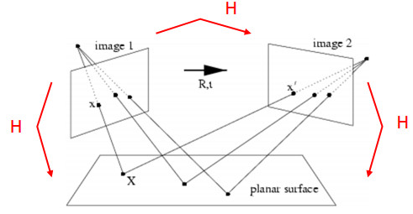
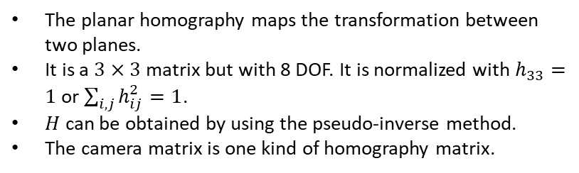
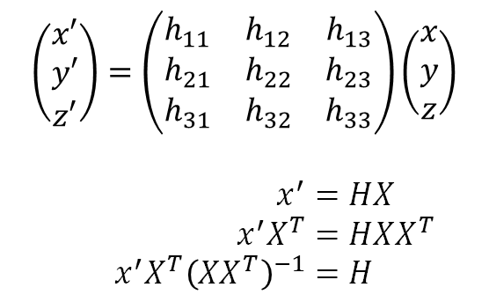

Lens Calibration
The homography matrix $H$
A planar surface and the image plane
$$\left(\begin{matrix}x′ \\ y′ \\ z′\end{matrix}\right)=\left(\begin{matrix}h_{11} & h_{12} & h_{13} \\ h_{21} & h_{22} & h_{23} \\ h_{31} & h_{32} & h_{33}\end{matrix}\right)\left(\begin{aligned}x \\ y \\ z\end{aligned}\right)$$
$$x^{′}=HX \\ x^{′}X^{T}=HXX^{T} \\ x^{′}X^{T}{\left(XX^{T}\right)}^{−1}=H$$
The planar homography maps the transformation between two planes.
It is a $3×3$ matrix but with 8 DOF. It is normalized with $h_{33}=1$ or $\sum_{i,j}{h_{ij}^{2}}=1$.
$H$ can be obtained by using the pseudo-inverse method.
The camera matrix is one kind of homography matrix.
Rotated and translated camera position

Slide 20
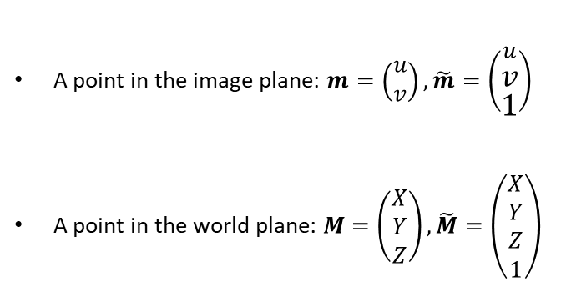
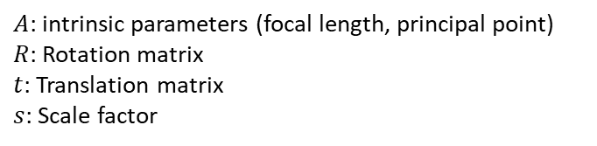
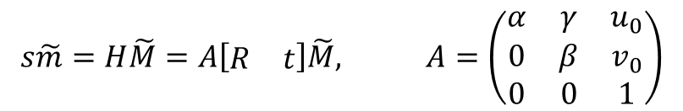
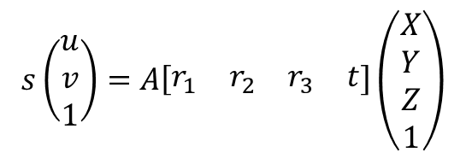
Lens Calibration
Zhengyou Zhang’s Camera Calibration method
A point in the image plane: $m=\left(\begin{aligned}u \\ v\end{aligned}\right), \tilde{m}=\left(\begin{aligned}u \\ v \\ 1\end{aligned}\right)$
A point in the world plane: $M=\left(\begin{aligned}X \\ Y \\ Z\end{aligned}\right), \tilde{M}=\left(\begin{aligned}X \\ Y \\ Z \\ 1\end{aligned}\right)$
$$s\tilde{m}=H\tilde{M}=A\left[\begin{matrix}R & t\end{matrix}\right]\tilde{M}, A=\left(\begin{matrix}α & γ & u_{0} \\ 0 & β & v_{0} \\ 0 & 0 & 1\end{matrix}\right)$$
$A$: intrinsic parameters (focal length, principal point)
$R$: Rotation matrix
$t$: Translation matrix
$s$: Scale factor
$$s\left(\begin{aligned}u \\ v \\ 1\end{aligned}\right)=A\left[\begin{matrix}r_{1} & r_{2} & r_{3} & t\end{matrix}\right]\left(\begin{aligned}X \\ Y \\ Z \\ 1\end{aligned}\right)$$

Slide 21

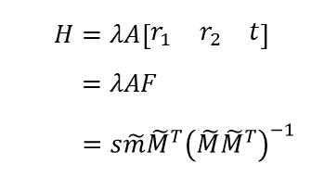
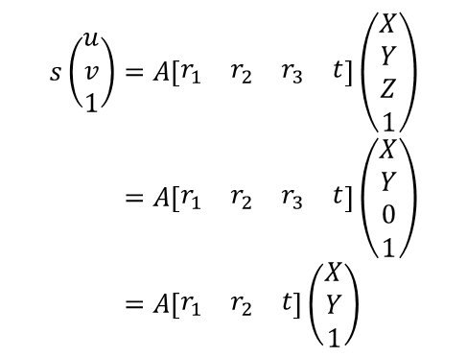


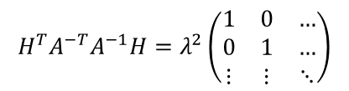
Lens Calibration
Zhengyou Zhang’s Camera Calibration method
We assume the model plane is on $Z=0$. Then,
If we dot product both side with $H^{T}A^{−T}A^{−1}$, we have
$$s\left(\begin{aligned}u \\ v \\ 1\end{aligned}\right)=A\left[\begin{matrix}r_{1} & r_{2} & r_{3} & t\end{matrix}\right]\left(\begin{aligned}X \\ Y \\ Z \\ 1\end{aligned}\right) \\ =A\left[\begin{matrix}r_{1} & r_{2} & r_{3} & t\end{matrix}\right]\left(\begin{aligned}X \\ Y \\ 0 \\ 1\end{aligned}\right) \\ =A\left[\begin{matrix}r_{1} & r_{2} & t\end{matrix}\right]\left(\begin{matrix}X \\ Y \\ 1\end{matrix}\right)$$
$$H^{T}A^{−T}A^{−1}H=H^{T}\left(A^{−T}A^{−1}H\right) \\ =H^{T}\left(λA^{−T}F\right) \\ =\left(λF^{T}A^{T}\right)\left(λA^{−T}F\right) \\ =λ^{2}F^{T}A^{T}A^{−T}F \\ =λ^{2}F^{T}F \\ =λ^{2}\left[\begin{aligned}r_{1}^{T} \\ r_{2}^{T} \\ t^{T}\end{aligned}\right]\left[\begin{matrix}r_{1} & r_{2} & t\end{matrix}\right]$$
We now have the homography matrix $H$,
$$H=λA\left[\begin{matrix}r_{1} & r_{2} & t\end{matrix}\right] \\ =λAF \\ =s\tilde{m}{\tilde{M}}^{T}{\left(\tilde{M}{\tilde{M}}^{T}\right)}^{−1}$$
Using the knowledge that $r_{1}$ and $r_{2}$ are orthonormal, we have
$$H^{T}A^{−T}A^{−1}H=λ^{2}\left(\begin{matrix}1 & 0 & … \\ 0 & 1 & … \\ ⋮ & ⋮ & ⋱\end{matrix}\right)$$
where $λ$ is an arbitrary scalar and $F=\left[\begin{matrix}r_{1} & r_{2} & t\end{matrix}\right]$.

Slide 22


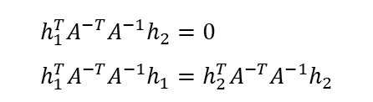


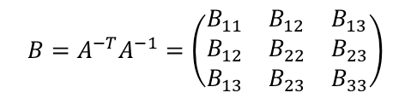
Lens Calibration
Zhengyou Zhang’s Camera Calibration method
Let’s denote $H=\left[\begin{matrix}h_{1} & h_{2} & h_{3}\end{matrix}\right]$.
Then we can readily derive that
We can get two constraints from the above equation.
$$h_{i}^{T}Bh_{j}=v_{ij}^{T}b$$
$$h_{1}^{T}A^{−T}A^{−1}h_{2}=0 \\ h_{1}^{T}A^{−T}A^{−1}h_{1}=h_{2}^{T}A^{−T}A^{−1}h_{2}$$
Inserting the above into the two constraints, they can be rewritten as,
Let $B=A^{−T}A^{−1}$. Then $B$ is symmetric.
$$\left(\begin{matrix}v_{12}^{T} \\ {\left(v_{11}−v_{22}\right)}^{T}\end{matrix}\right)b=0$$
$$B=A^{−T}A^{−1}=\left(\begin{matrix}B_{11} & B_{12} & B_{13} \\ B_{12} & B_{22} & B_{23} \\ B_{13} & B_{23} & B_{33}\end{matrix}\right)$$
Define a six-dimensional vector $b$ and $v$ such that
$$b≡{\left(\begin{matrix}B_{11} & B_{12} & B_{13} & B_{22} & B_{23} & B_{33}\end{matrix}\right)}^{T}$$
$$v_{ij}≡{\left(\begin{matrix}h_{i1}h_{j1} & h_{i2}h_{j2}+h_{i2}h_{j1} & h_{i2}h_{j2} & h_{i3}h_{j1}+h_{i1}h_{j3} & h_{i3}h_{j2}+h_{i2}h_{j3} & h_{i3}h_{j3}\end{matrix}\right)}^{T}$$
where $h_{i}={\left[\begin{matrix}h_{i1} & h_{i2} & h_{i3}\end{matrix}\right]}^{T}$ is the $i$th column of $H$.

Slide 23


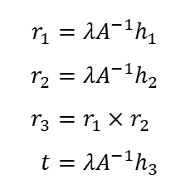


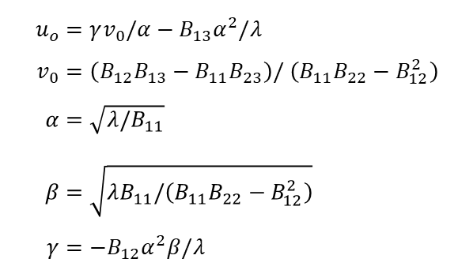


Lens Calibration
Zhengyou Zhang’s Camera Calibration method
If there are $n$ images, by stacking $n$ such equations, we have
$$u_{o}=γv_{0}/α−B_{13}α^{2}/λ \\ v_{0}=\left(B_{12}B_{13}−B_{11}B_{23}\right)/ \left(B_{11}B_{22}−B_{12}^{2}\right) \\ α=\sqrt{λ/B_{11}} \\ β=\sqrt{λB_{11}/\left(B_{11}B_{22}−B_{12}^{2}\right)} \\ γ=−B_{12}α^{2}β/λ$$
$$Vb=0$$
where $V$ is a $2n×6$ matrix.
Solution: eigenvectors of $V^{T}V$ with the smallest eigenvalues.
$$V^{T}Vb=0$$
where ${\left(V^{T}V\right)}^{−1}$ is not exist.
Once the intrinsic parameters are obtained, the extrinsic parameters for each image are readily computed.
When $n≥3$, $b$ is obtained and then $B$ is known.
Since $H=λA\left[\begin{matrix}r_{1} & r_{2} & t\end{matrix}\right]$,
$$r_{1}=λA^{−1}h_{1} \\ r_{2}=λA^{−1}h_{2} \\ r_{3}=r_{1}×r_{2} \\ t=λA^{−1}h_{3}$$
$$b→B→A→α,β,γ,u_{0},v_{0}$$
All the intrinsic parameters are obtained.

Slide 24
Lens Calibration
OpenCV python test code: Spot searching
Before
After

Slide 25
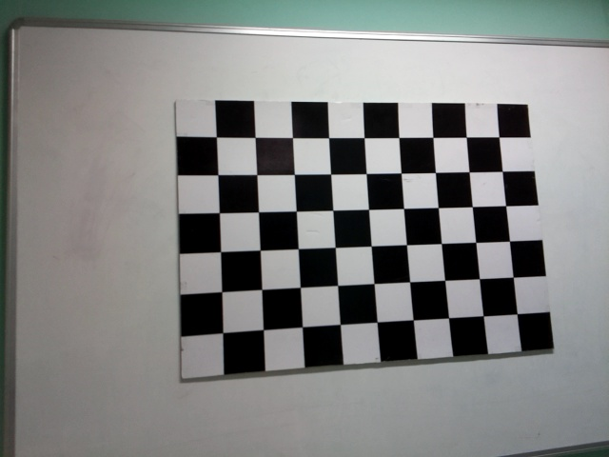
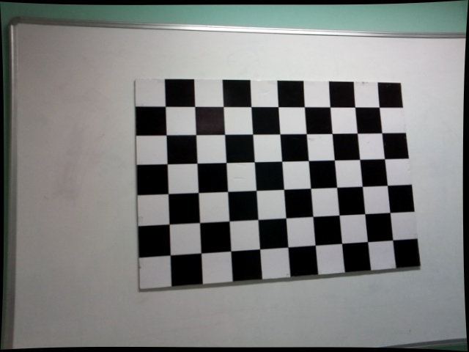
Lens Calibration
OpenCV python test code: Undistort the image
Before
After
Barrel distortion

Slide 26
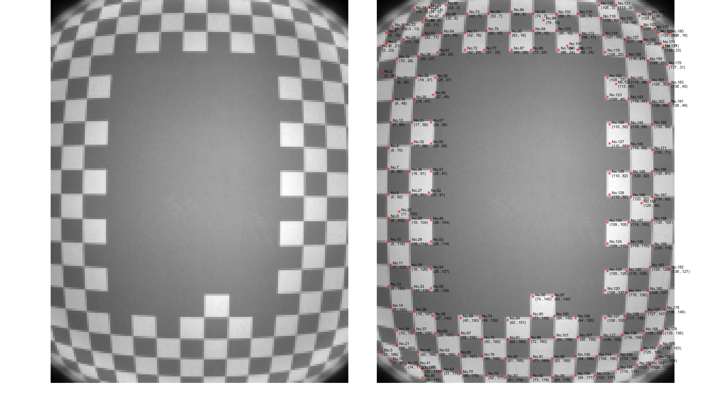

Lens Calibration
Lens Calibration in Jasper
80cm
90cm
100cm

Slide 27

Lens Calibration
Can it be directly applied to IMX459?
LiDAR has all three coordinates, $\left(x,y,z\right)$. Then why should we adopt the calibration method for the 2D camera? Shouldn’t we calibrate LiDAR using the spherical coordinate?

